Slide 1
AcuLive:
Protecting Smart Assistants from Smarter Attacks
Acoustic Liveliness Detection
Cyan Subhra Mishra | Gulsum Gudukbay | Sethu Jose
cyan@psu.edu | gulsum@psu.edu | sethu@psu.edu

Slide 2
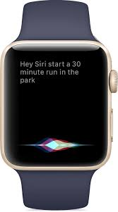
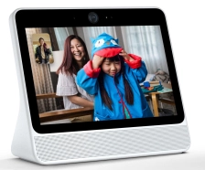
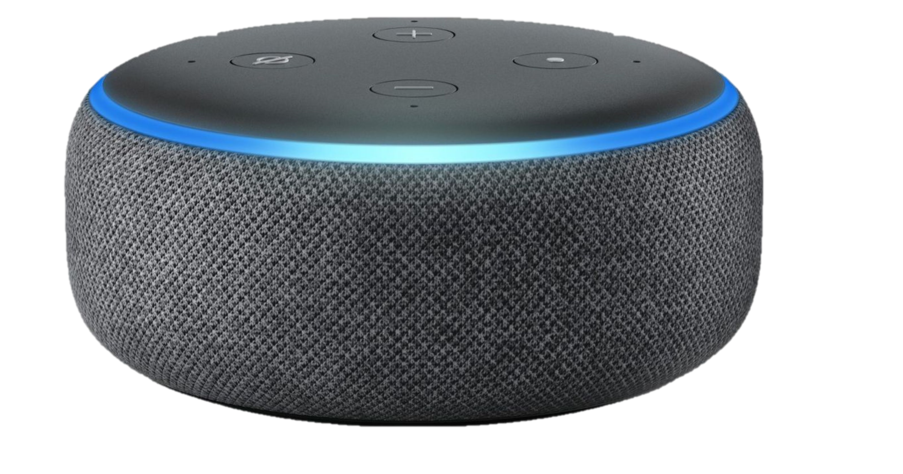
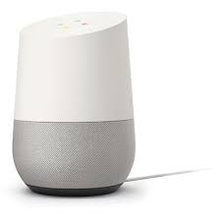

Motivation – Voice Assisted Devices
Prevalent but unsecure
Direct and Indirect attacks
Activation by Recorded Voice of owner
Breach by inaudible frequencies

Slide 3
Motivation – Voice Assisted Devices
Protect Them from Digital Break-ins
Voice Profile Match
Securing from inaudible frequencies
Two factor authentication

Slide 4
Key Challenges
Finding Pattern
Privacy
Scalability
Gathering Data
Accuracy
Speed
Cost

Slide 5
What If Adversary Tries To Breach By Using Owners’ Recorded Voice?
AcuLive

Slide 6
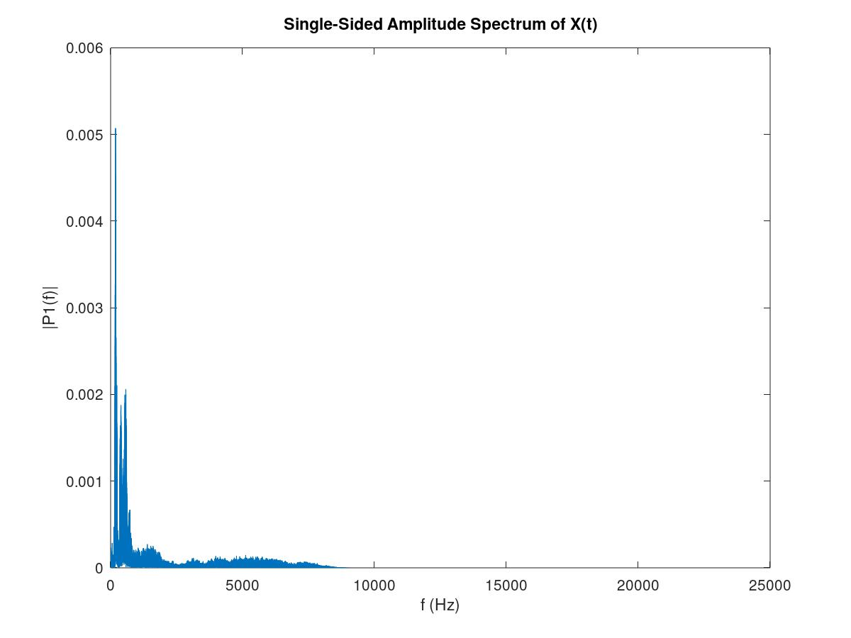
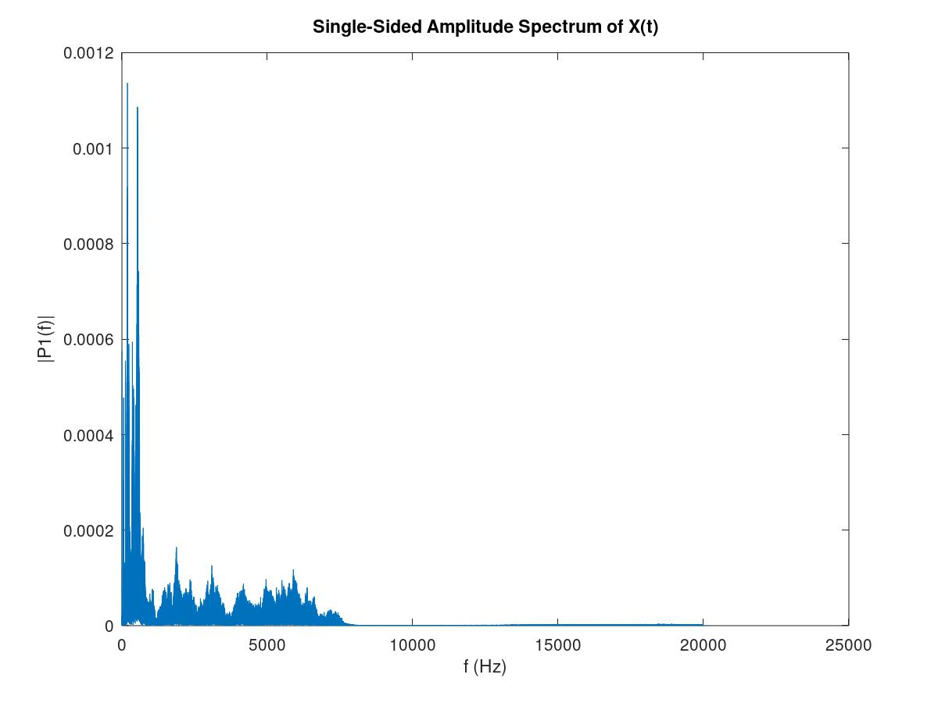
Finding a Pattern
Tested on a open voice data set, with more than 60 samples and multiple devices
Actual Voice
Recorded Voice

Slide 7
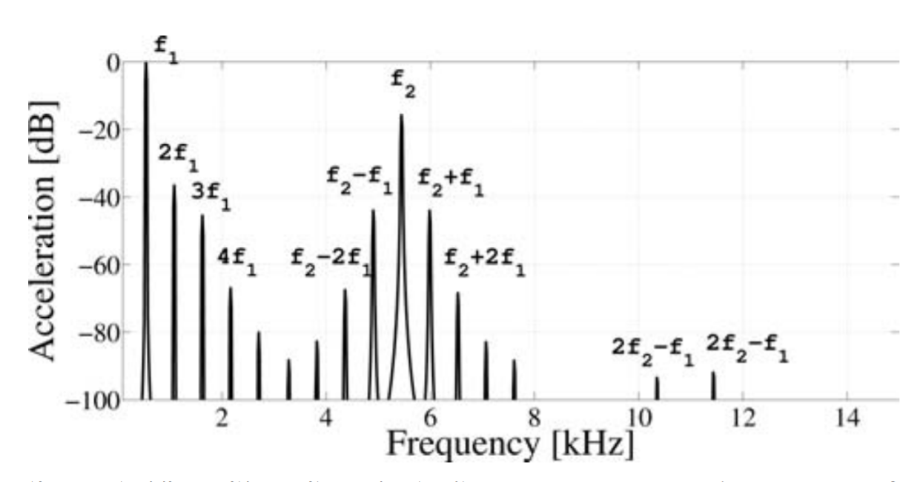
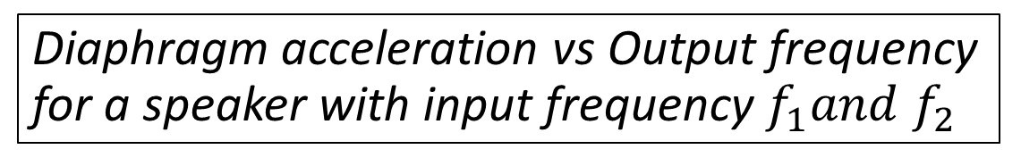
Understanding the FFT Pattern
Speakers are non-linear
Higher order harmonics will be observed
Unavoidable And Prominent In All Speakers: The Pattern Is Coherent And Prevalent
Diaphragm acceleration vs Output frequency for a speaker with input frequency $f_{1}and f_{2}$

Slide 8
Data Collection and Conditioning
Band-pass to remove inaudible
1KHz - 10KHz

Slide 9
Building Classifiers
Naïve Thresholding
Triangulation Thresholding
Linear Regression

Slide 10
Naïve Thresholding
Actual Voice
Recorded Voice
Segregation Point
Segregation Point

Slide 11
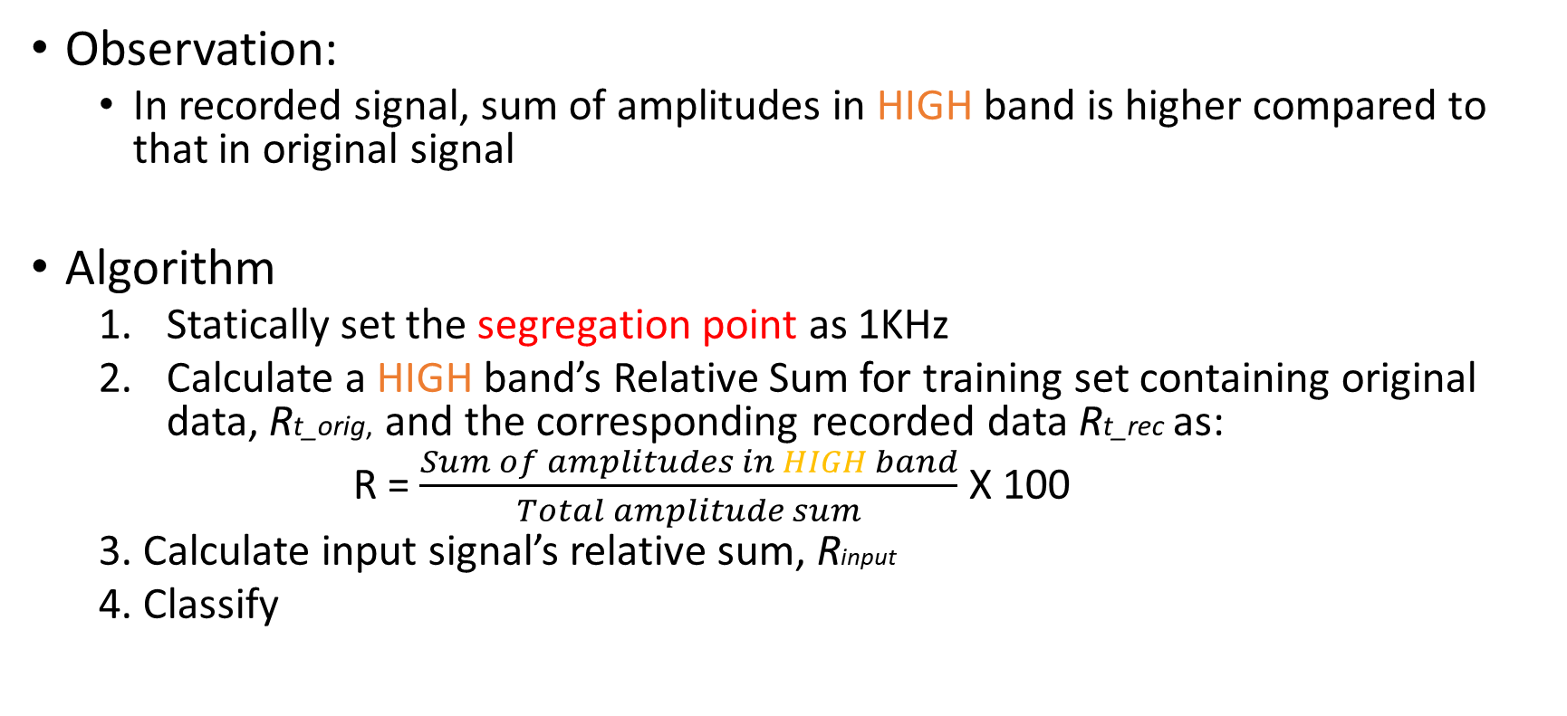
Naïve Thresholding
Observation:
In recorded signal, sum of amplitudes in HIGH band is higher compared to that in original signal
Algorithm
Statically set the segregation point as 1KHz
Calculate a HIGH band’s Relative Sum for training set containing original data, Rt_orig, and the corresponding recorded data Rt_rec as:
R = $\frac{Sum of amplitudes in HIGH band}{Total amplitude sum}$ X 100
3. Calculate input signal’s relative sum, Rinput
4. Classify

Slide 12
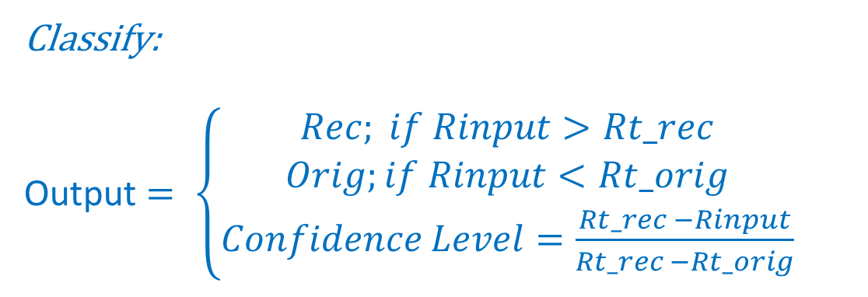
Naïve Thresholding
Classify:
Output $= \left\{\begin{aligned}Rec; if Rinput>Rt_rec \\ Orig;if Rinput<Rt_orig \\ Confidence Level=\frac{Rt_rec −Rinput}{Rt_rec −Rt_orig}\end{aligned}\right.$
Advantages
Easy to Implement
User Configurable
Disadvantages:
Static Thresholding
Easily Biased By The Outliers
Does Not Adapt
Too Many False Positives

Slide 13
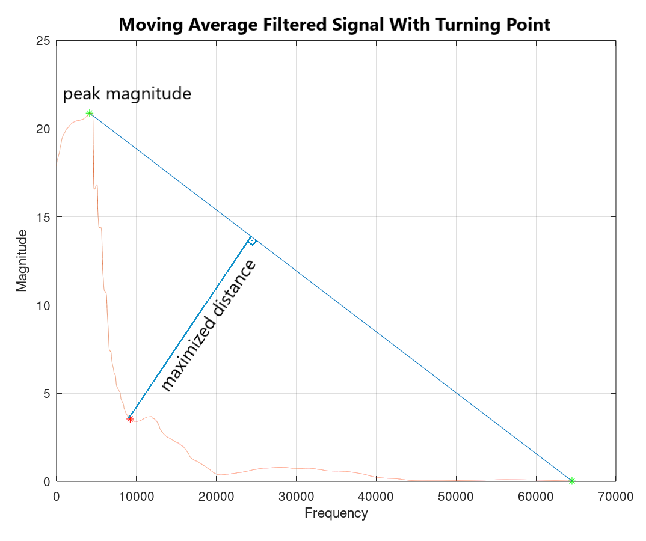
Triangular Thresholding
The convolution is enclosed in a right triangle between the maximum peak and the last data point
Find the x-value of the point with the greatest distance between the point and the hypotenuse of the triangle, in a line perpendicular to the hypotenuse.

Slide 14
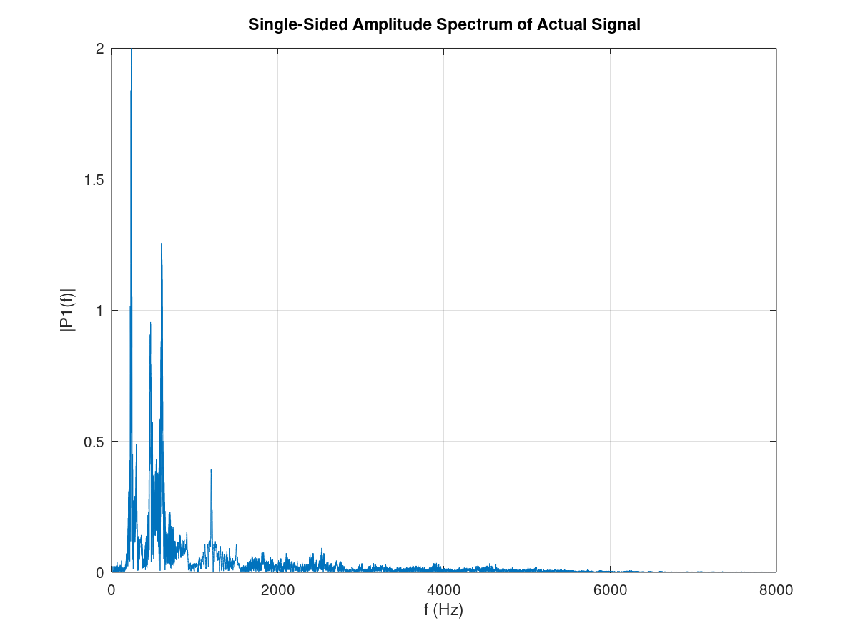
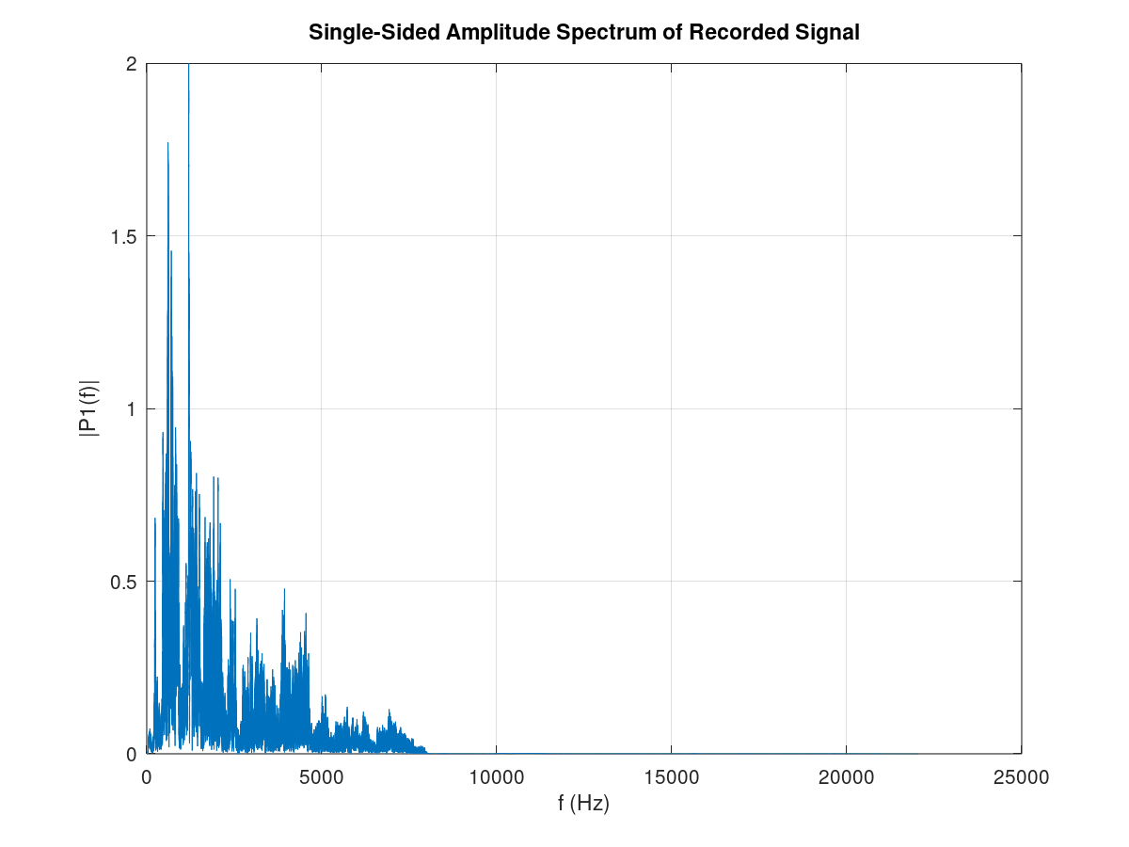
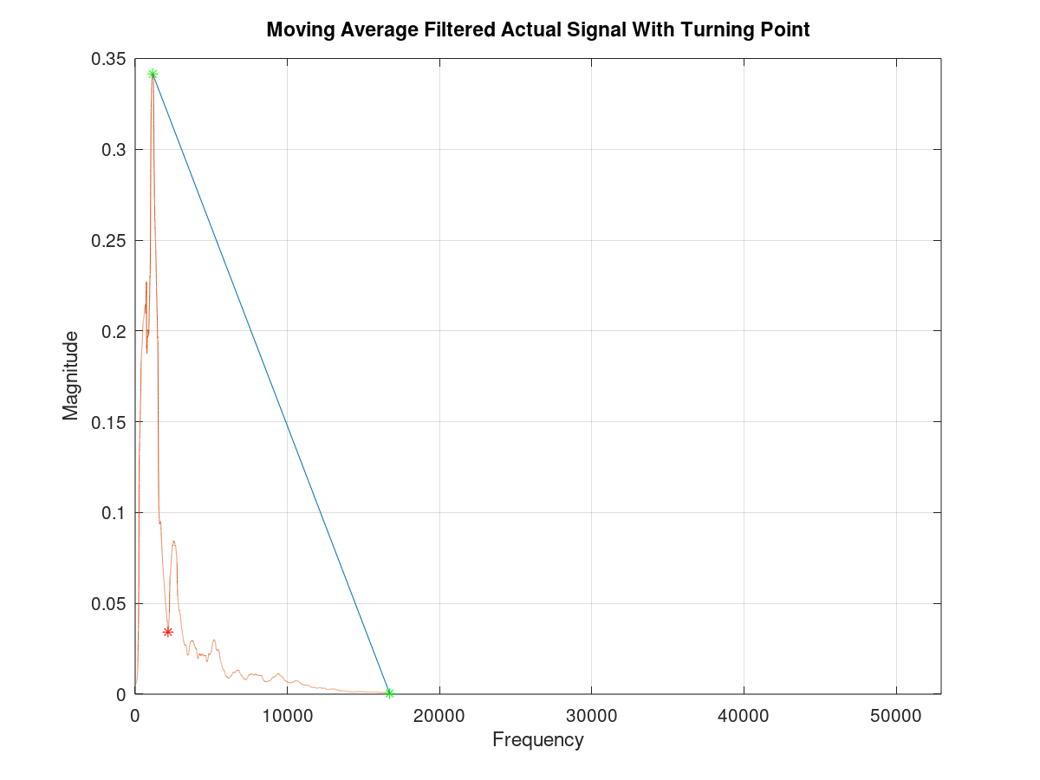
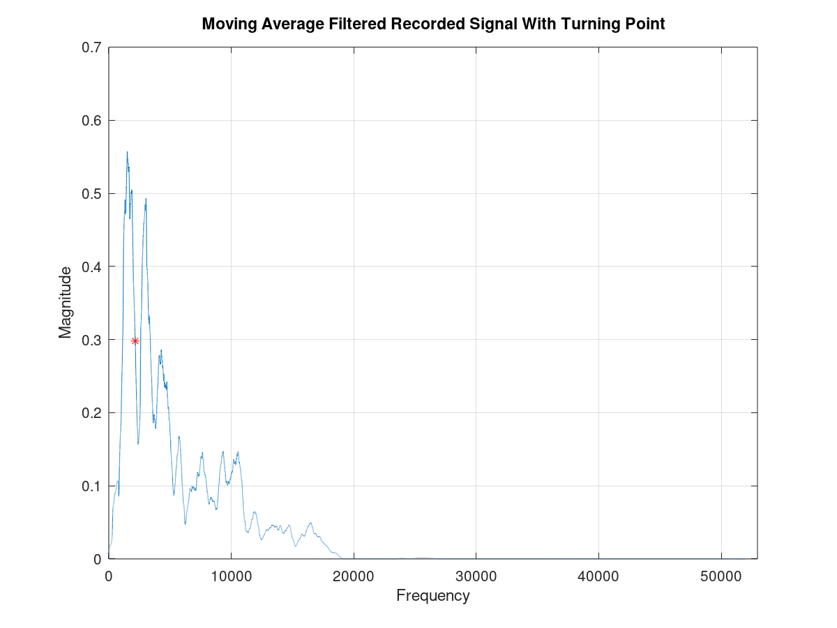

Slide 15
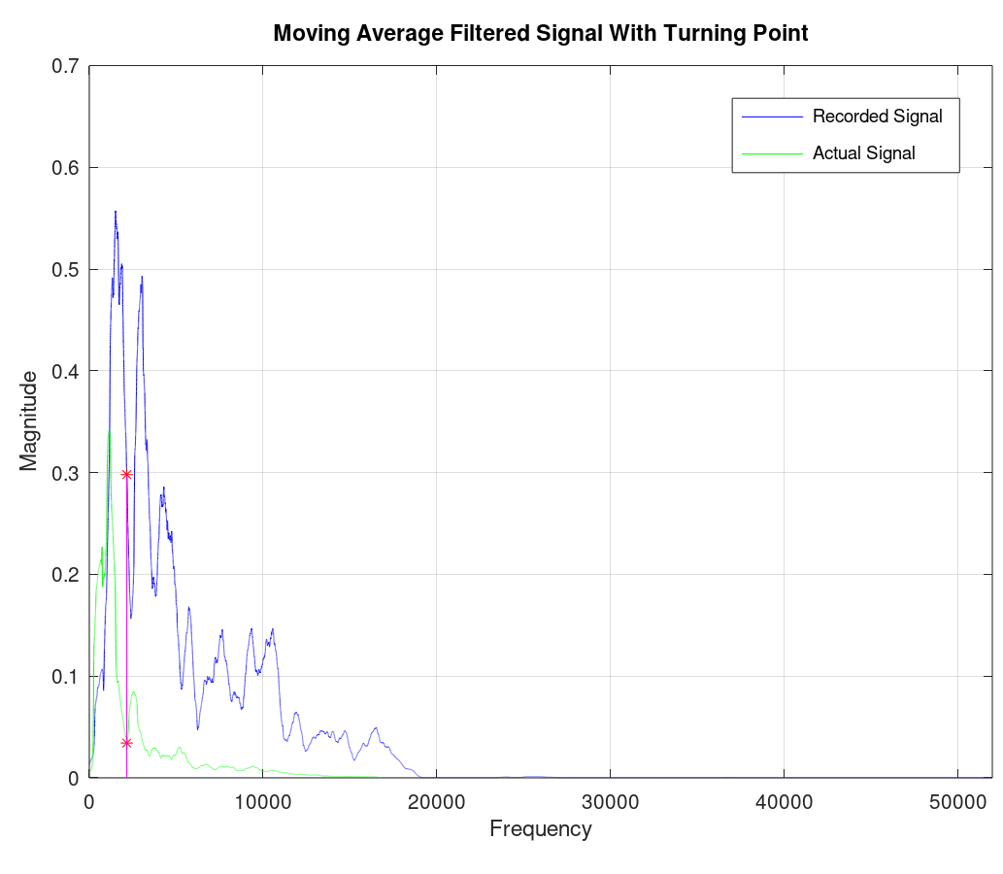
Triangular Thresholding: Results
We achieved a 100% accuracy with 65 sound samples.
The last 20 samples were noisy, where we played a high frequency music in the background and we still got completely accurate results.
The 100% accuracy was achieved when the threshold for the differences between recorded and actual voice signal tail portion sums was 0.18.
This value also avoids false positives.
For larger thresholds, the accuracy decreased significantly and there were false positives.
Sum Differences Threshold | Accuracy %
0.18 | 100.00
0.30 | 98.46
0.40 | 83.08
0.50 | 64.62
0.60 | 58.46

Slide 16
Triangular Thresholding Demo

Slide 17
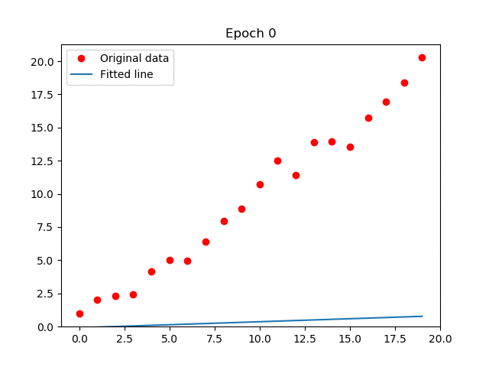
Linear Regression
Given points fit a straight line
Classification
Class 1: Above line
Class 2: Below line
One of the most simple Classifier

Slide 18
Linear Regression: Formulation
Trained Model
$$F(R, O)$$
Trained Model
𝐹(𝑅, 𝑂)
Moments
$$y_{μ}=m_{μ}∗ μ_{t}+c_{μ} \\ y_{σ}=m_{σ}∗ μ_{σ}+c_{σ}$$
𝑦_𝜇=𝑚_𝜇∗ 𝜇_𝑡+𝑐_𝜇 𝑦_𝜎=𝑚_𝜎∗ 𝜇_𝜎+𝑐_𝜎
$$C=f(y_{μ},y_{σ})$$
𝐶=𝑓(𝑦_𝜇,𝑦_𝜎)
$$Class= \left\{\begin{aligned}Rec;if C>thres \\ Act;if C<thres\end{aligned}\right.$$
𝐶𝑙𝑎𝑠𝑠= {█(𝑅𝑒𝑐;𝑖𝑓 𝐶>𝑡ℎ𝑟𝑒𝑠 @𝐴𝑐𝑡;𝑖𝑓 𝐶<𝑡ℎ𝑟𝑒𝑠)┤
Average $(μ_{t})$
Average (𝜇_𝑡)
Variance ${(σ}_{t})$
Variance 〖(𝜎〗_𝑡)

Slide 19
Linear Regression: Parameters
Regression on Mean
Regression on Variance
Best-fit values
Slope: 5.425 ± 0.8111
Y-intercept: 0.1050 ± 0.07025
95% Confidence Intervals
Slope: 3.835 to 7.015
Y-intercept: -0.03266 to 0.2427
Equation
Y = 5.425*X + 0.1050
Best-fit values
Slope 2.923 ± 1.258
Y-intercept 0.2674 ± 0.1091
95% Confidence Intervals
Slope 0.4561 to 5.389
Y-intercept 0.05352 to 0.4813
Equation
Y = 2.923*X + 0.2674

Slide 20
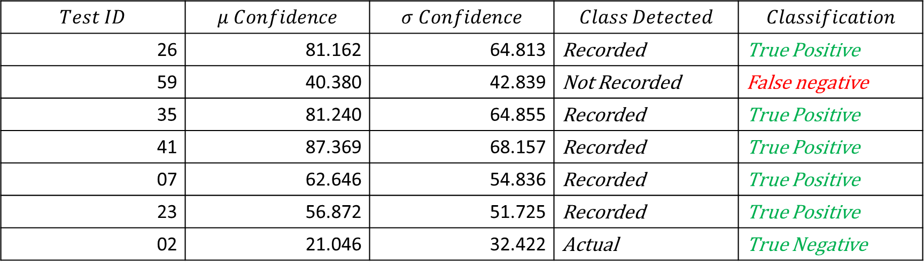
Linear Regression: Results
$$Test ID$$ | $$μ Confidence$$ | $$σ Confidence$$ | $$Class Detected$$ | $$Classification$$
26 | 81.162 | 64.813 | Recorded | True Positive
59 | 40.380 | 42.839 | Not Recorded | False negative
35 | 81.240 | 64.855 | Recorded | True Positive
41 | 87.369 | 68.157 | Recorded | True Positive
07 | 62.646 | 54.836 | Recorded | True Positive
23 | 56.872 | 51.725 | Recorded | True Positive
02 | 21.046 | 32.422 | Actual | True Negative
# Test Data | True Positive | True Negative | False Positive | False Negative
50 of 65 | 96% | 94% | 6% | 4%

Slide 21
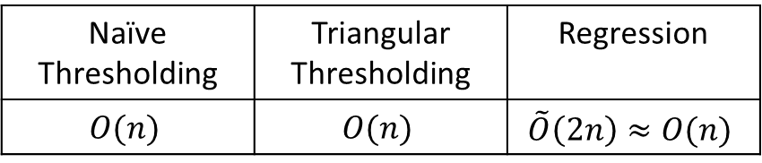
Evaluation
Runtime Comparison
Evaluation Platform
Naïve Thresholding | Triangular Thresholding | Regression
$$O(n)$$ | $$O(n)$$ | $$\tilde{O}\left(2n\right)≈O(n)$$
Evaluated with
Octave
Python (TensorFlow for Regression)
Potential Deploy Platform
Google Home
Alexa
Smart Watches
Mobile Phones
Average execution time for triangular thresholding: 1.27 sec.
Addressing Privacy
Whole processing can happen onboard

Slide 22
Key Questions and Contributions
Is this pattern prevalent?
Yes – Tested on a open audio dataset, and different recording devices
Do we need to analyze the entire audio spectrum?
No – Human acoustic range: 80Hz to 180Hz (Male), 165Hz to 255Hz (Female)
Do we need to add extra hardware?
No – AcuLive builds on the existing infrastructure (including smartwatches)
What are the performance and power tradeoffs?
Proposed algorithm is linear time, adaptive
Privacy?
Simpler algorithm – runs on the device, NO cloud connection needed

Slide 23
Application Domain
AcuLive combined with the available techniques can protect from
Stealthy Attack
For inaudible sounds
Biometric Override Attack
Previously Recorded Sounds
Acoustic Injection Attack
Loud noises to corrupt the sensor data

Slide 24
Conclusion and Future Work
AcuLive uses frequency profile – can help us in detecting recorded voice
Easy to deploy and needs no further hardware and highly scalable
Aculive uses the base property of a speaker – so not so easy to fool it
But needs further improvement
We can make it adaptive (beyond regression)
Instead of linear classifier, we can use non-linear classifier
Understand and test with advanced audio devices
Hardware to detect vocal chord vibration – can further strengthen
Stealthy attack handling for inaudible sound signals and shadow frequencies.
Energy requirements should be investigated

Slide 25
References
Nirupam Roy, Haitham Hassanieh, and Romit Roy Choudhury. 2017. Backdoor: Making microphones hear inaudible sounds. In Proceedings of the 15th Annual International Conference on Mobile Systems, Applications, and Services. ACM, 2–14.
G.W. Zack, W.E. Rogers, S.A. Latt, Automatic measurement of sister chromatid exchange frequency, J. Histochem. Cytochem. 25 (7) (1977) 741-753.
Erza, Mehran & Gaviot, E & Lemarquand, Guy & Tournier, Pascal & Camberlein, Lionel & Stephane, Durand & Polet, Frederic. (2015). A Versatile Model of Nonlinear Electrodynamic Loudspeaker Co-Operating with the Amplifier Designed by Way of Advanced Software. Archives of Acoustics. 39. 10.2478/aoa-2014-0006.

Slide 26


Thank You ☺

